Slide 1
How to Reduce Harassment in the Workplace? Questions Employers Should Pose
Tim K. Garrett

Slide 2
How Can an Employer Reduce Workplace Harassment?
Prevalent Question in Culture
#Metoo
#Timesup
But has been a recognized claim since 1986
Savvy employers know:
Must have policy prohibiting unlawful harassment
Publicized
With effective complaint procedure
Should conduct training
Managers
At least train those charged with enforcement
But, Studies show that policy + training not effective
Why?
Today’s Presentation – Practical Guidance
Three questions employers should ask in trying to “cultivate a healthy workplace environment”

Slide 3
Refresher
What is unlawful harassment?
A form of “unlawful discrimination,” meaning some differing treatment based upon protected characteristic
The differing treatment creates a “hostile work environment” based upon that protected characteristic
Unwelcome and severe or pervasive conduct
Directed toward another based on that persons’ “protected status”
Race, sex, religion, age, disability, etc.
Including the employee’s “protected activity”

Slide 4
Elements of Claim
Victim member of protected “class” (expansive reading in today’s culture)
Harassment based on protected class
Harassment unwelcome and severe or pervasive (objectively and subjectively)
Special elements depending on job title of alleged harasser
If manager and if tangible job action – no defense
If manager and hostile environment – defense
If co-worker – employee has to prove negligence

Slide 5
Factors Considered
Is conduct verbal or physical or both?
Frequency of conduct – single incident or pattern?
Patently offensive or “ambiguous”?
Co-worker or manager?

Slide 6
Examples
“Leering”
Shoulder massage or suggestive touching/hugging
Leaning over – getting in personal space in offensive manner
Inappropriate jokes
Taking about personal sex life

Slide 7
Questions to Ask
Do employees perceive the anti-harassment policy has integrity?
Do employees perceive the training as merely litigation risk avoidance, or as an attempt at properly cultivating a healthy workplace?
Do employees perceive commitment “at the top”?

Slide 8
Do Employees Perceive the Policy Has integrity?
This is revealed in the small details, not the “big” complaints.
Do management’s actions inform employees that management cares about their concerns?
Or, are seemingly “minor” complaints dismissed as unimportant
In life we learn the seemingly little things become the big things
Seat-belt story
Enforcement must balance the interests of various constituencies
Victim
Alleged harasser
Other employees
Process itself
Balance under-reacting (management does not care) and over-reacting (complaints potentially can become misused)
Example – what do you do with anonymous complaint?

Slide 9
Training – Merely Litigation Risk Avoidance?
Is training for information or for transformation?
Information
Here are the rules and policies
Don’t do that
No wonder training not effective
Worse – here are the rules, obey or we get sued (or you get fired)
Fear-based only (parent example)
Compliance suffers – message could be heard – “cover it up”
Message also – Company cares only about its risk, not about its employees
Not a healthy narrative
“Most valuable asset” policy
Transformation – What are the reasons for the rules? What are the purposes behind policies?
Can our management team articulate those deeper purposes?

Slide 10
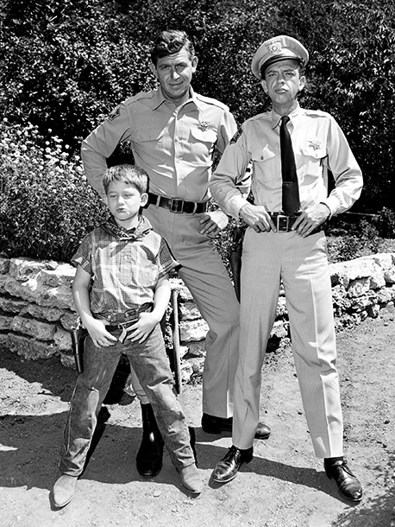
Training – Merely Litigation Risk Avoidance? (cont’d)
Barney Fife or Andy Taylor?

Slide 11
Training – Merely Litigation Risk Avoidance? (cont’d)
Barney Fife or Andy Taylor?
Rules are primary (Barney)
Relationships are primary (Andy)
What relationships do the rules really serve?
Analysis can be scary but also transforming
Leads to a more fundamental question: What is our work really for? Is my work only for me?
If Company message is do this for Company’s “bottom line,” then such selfish view is promoted, not rebutted.
Can we have a workplace that recovers the idea that human work is not merely a job but a calling
Not merely about my own advancement but also about the good of the community in which I serve
Leads to strong “other-mindedness” in our work
Dr. Martin Luther King, Jr.: “Life’s most urgent and persistent question is ‘What are you doing for others?’”

Slide 12
Do my employees perceive this tone “at the top”?
This transformation process can only be accomplished if there is commitment from the very top of the organization.
Drug testing policy example
Each individual is the greatest contributor to the type of workplace she would want to work in
And the most influential
Those considered “leaders”
will have greatest impact on cultivating this type of community
But only if actions reinforce the ideals.
“I cannot hear what you are saying because your actions speak so loudly.”

Slide 13
Questions to Ask To Cultivate Healthy Workplace - Recap
Do employees perceive the anti-harassment policy has integrity?
(Do we show we care?)
Do employees perceive the training as merely litigation risk avoidance, or as an attempt at properly cultivating a healthy workplace?
(Is our care “other-minded” or “team-oriented”?)
Do employees perceive commitment “at the top”?
(Do our actions as managers/leaders conform to our professed ideals?)

Slide 14
Thanks!
Questions?

Slide 15
Tim K. Garrett
(615) 742-6270
tgarrett@bassberry.com

